Slide 1

Wellness and Lower Health Care Costs:
Everything You Need to Know
Steven Aldana, Ph.D.
CEO WellSteps

Slide 2
Percent of GDP Going to Health Care
Today 18%
of GDP

Slide 3
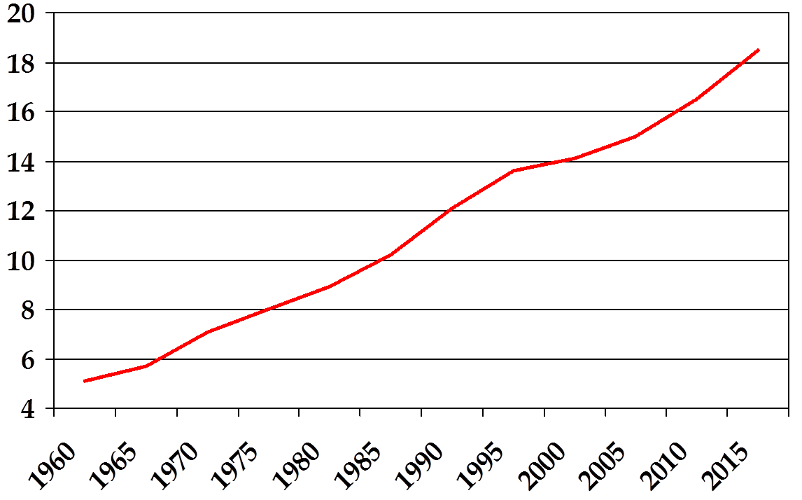
U.S. Health Care as a Percentage of the GDP

Slide 4
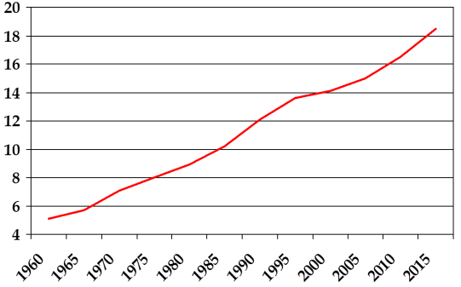
U.S. Health Care as a Percentage of the GDP

Slide 5
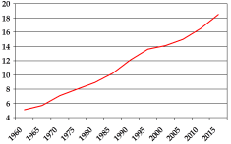
U.S. Health Care as a Percentage of the GDP

Slide 6
January 10, 2223 Doctor Day in American

Slide 8
Medical Costs per Person per Year
Kaiser Family Foundation
Notes:
854

Slide 9
Medical Costs per Person per Year
Kaiser Family Foundation
Notes:
854

Slide 10
Health Insurance Premiums, Earnings and Inflation, 1999-2012
http://kff.org/health-costs/slide/cumulative-increases-in-health-insurance-premiums-workers-contributions-to-premiums-inflation-and-workers-earnings-1999-2012/

Slide 11
The Problem
Health care costs have and will continue to increase.
They will increase faster than salaries and inflation.
Employers and employees will carry the burden.
What can wellness do to slow the cost increases?

Slide 12
Drivers of Health Care Costs
Unhealthy behaviors
Salary and drug costs
Expensive technologies
Fragmented care
Lack of cost consideration
Fee for service
High admin costs
End-of-life care
Provider consolidation
http://web1.millercenter.org/commissions/healthcare/HealthcareCommission-Report.pdf

Slide 13
Cost Reduction Strategies
Drop insurance-cost shift
Change carriers
Negotiate rates
Self insure
High deductible plans
Onsite clinics
Disease management
Wellness

Slide 14
Drivers
Strategies
Unhealthy behaviors
Salary and drug costs
Expensive technologies
Fragmented care
Lack of cost consideration
Fee for service
High admin costs
End-of-life care
Provider consolidation
Drop insurance-cost shift
Change carriers
Negotiate rates
Self insure
High deductible plans
Onsite clinics
Disease management
Wellness

Slide 15
Drivers
Strategies
Unhealthy behaviors
Salary and drug costs
Expensive technologies
Fragmented care
Lack of cost consideration
Fee for service
High admin costs
End-of-life care
Provider consolidation
Drop insurance-cost shift
Change carriers
Negotiate rates
Self insure
High deductible plans
Onsite clinics
Disease management
Wellness

Slide 16
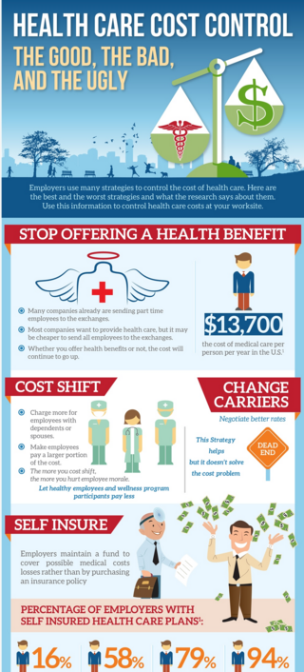
Health Care Cost Control
https://www.wellsteps.com/infographics
Self insure saves 4-7%
High deductibles save 5-14%
Notes:
Self insure saves 4-7% high deductibles save

Slide 17
Where Your Insurance Premium Goes
Notes:
Which of these can be impacted by wellness?

Slide 18
You save the most when you stay out of the health care system.

Slide 19
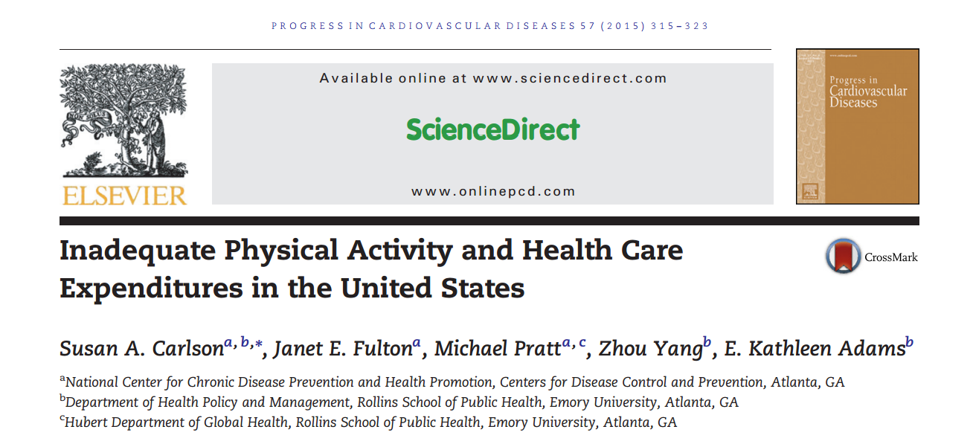
An Example of the Evidence

Slide 20
Inadequate Physical Activity and Health Care
Expenditures in the United States
National Health Interview Survey (2004–2010) merged with Medical Expenditure Panel Survey
58,000 US adults
https://www.cdc.gov/nccdphp/dnpao/docs/carlson-physical-activity-and-healthcare-expenditures-final-508tagged.pdf

Slide 21
Inadequate Physical Activity and Health Care
Expenditures in the United States
+$1,313
+$576
(≥150 min/week)

Slide 22
Percent of Health Care Costs Caused By:
$3 trillion

Slide 23
Percent of Health Care Costs Caused By:
$3 trillion
Add substance abuse, stress, accidents, diet, etc total = 70%
See References

Slide 24
Additional Health Care Costs per Condition per Person per Year
See References

Slide 25
For every 1% drop in total cholesterol, the risk of having a heart attack drops by 2–3%
For every one-point drop in elevated diastolic blood pressure, there is another 2–3% drop in heart attack risk
NEJM

Slide 26

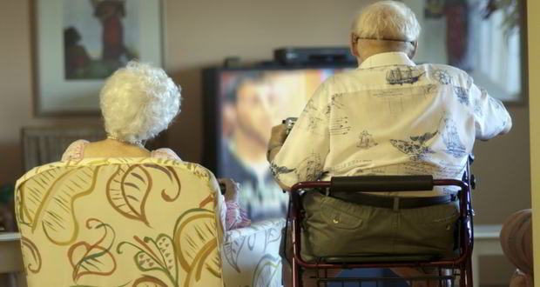
http://www.nejm.org/doi/pdf/10.1056/NEJMsa020614
Comparison of Health Care Costs
to End of Life
vs
Difference in lifespan, little difference
in medical costs

Slide 27
Randomized Clinical Trials
The only valid studies?
Other studies?

Slide 28
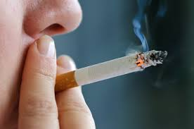
There is no proof tobacco kills

Slide 29
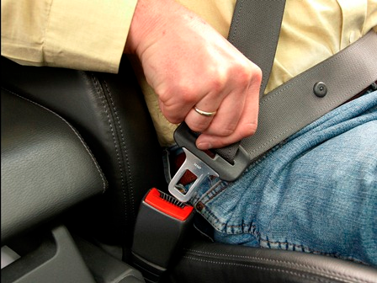
There is no proof seatbelts save lives

Slide 30

No proof of the health benefits of organic foods

Slide 31
Companies don’t like to be randomized.

Slide 32

Yet, Common Sense Prevails

Slide 33
Where are the studies behind:
Retirement package
Paid time off (PTO)
Safety programs
Health care benefits
Vacation days
Company app
Name a single business strategy with
more science behind it than wellness

Slide 34
Wellness Model
Health Care
Costs
Unhealthy
behaviors
Health
risks
Chronic
disease

Slide 35
Most health care costs are caused by poor lifestyle behaviors.

Slide 36

Behavior Change is the Key
Policy and Environment
Skills and Tools
Motivation
Awareness and Education

Slide 37
Policy and Environment
40%
Skills and Tools
25%
Motivation
Awareness and Education
30%
5%

Slide 38
1) Find a reason to change
Policy and Environment
Skills and Tools
Motivation
Awareness and Education

Slide 39

1) Find a reason to change
Motivation
Awareness and Education

Slide 40
1) Find a reason to change
Awareness
  Biometric screening, HRA, education, preventive screening
Motivation
  Intrinsic vs extrinsic motivators
  Carrots vs Sticks
  Benefits based rewards, outcome based rewards

Slide 41
2) Learn new skills
Policy and Environment
Skills and Tools
Motivation
Awareness and Education

Slide 42

2) Learn new skills

Slide 43
2) Learn new skills
Fast food selections
Food preparation
Learn to schedule time to be active
Learn how to be active
Balance time demands
Show me how to do this...

Slide 44
3) Get help from others
Policy and Environment
Skills and Tools
Motivation
Awareness and Education

Slide 45

3) Get help from others

Slide 46
3) Get help from others
Policy
  Flexible schedules
  Healthy food options at work
  Healthy environment at work and home
Support from others
  Spouses/significant others
  Social support at work
  Social media

Slide 47
Skeptics Sound Off
Wellness doesn’t reduce health care costs
Wellness doesn’t work
Wellness is a waste of time

Slide 48
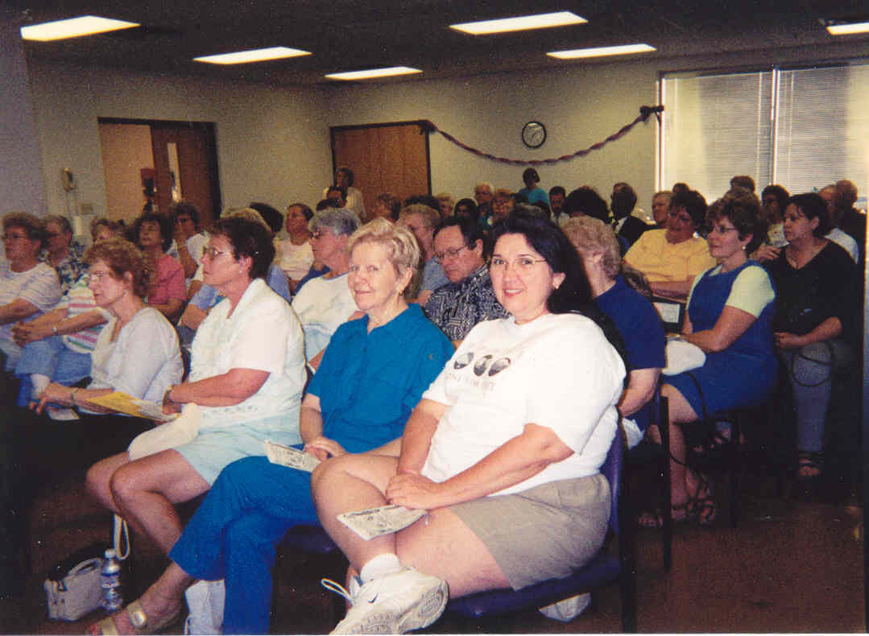
Coronary Health Improvement Program
(CHIP)

Slide 49
Fruit and Vegetable Servings
J Am Diet Assoc. 2005;105:371-381.

Slide 50
Whole Grain Servings
J Am Diet Assoc. 2005;105:371-381.

Slide 51
Grams of Saturated Fat
J Am Diet Assoc. 2005;105:371-381.

Slide 52
Steps per Week
J Am Diet Assoc. 2005;105:371-381.

Slide 53
Systolic Blood Pressure Reductions mm/Hg
J Am Diet Assoc. 2005;105:371-381.

Slide 54
Diastolic Blood Pressure Reductions mm/Hg
J Am Diet Assoc. 2005;105:371-381.

Slide 55
Total Cholesterol Reductions mg/dl
J Am Diet Assoc. 2005;105:371-381.

Slide 56
Glucose Reductions mg/dl
J Am Diet Assoc. 2005;105:371-381.

Slide 57
Wellness Model
Health Care
Costs
Unhealthy
behaviors
Health
risks
Chronic
disease

Slide 58

Comprehensive Wellness Programming
Health Assessment
Incentives
Culture Change
Biometric screening
Behavior Change
Campaigns
Health Coaching
Rewards Activity Tracker
WellSteps Guide
Screening Reminder
Wearables
Notes:
WellSteps creates & delivers the communication pieces

Slide 59

Self funded
Wellness program started in 2004
Included biometric screening
Small campaigns
41% participation
Significant incentive program
J Public Health Manag Pract. 2011 May-Jun;17(3):225-32
Notes:
Case study of Salt Lake county. I’m currently publishing the results of this program . A ROI of 3.35 for there wellness programs. Brokers had not involvment in the program. Currently, thats a common them across champion programs.

Slide 60
Salt Lake County Wellness Program
Average Cost Per Claim
J Public Health Manag Pract. 2011 May-Jun;17(3):225-32

Slide 61
Salt Lake County Wellness Program
Average Cost Per Claim
J Public Health Manag Pract. 2011 May-Jun;17(3):225-32

Slide 62
Program Cost | Program Savings | ROI
$1,456,788 ($919,542 for incentives) | $4,841,898 | $3,385,110
Cost Benefit Ratio of 3.32
J Public Health Manag Pract. 2011 May-Jun;17(3):225-32

Slide 63
Predicted vs Actual Health Care Costs
Predicted
Actual
WellSteps
Begins
Predicted values from:
http://kff.org/interactive/premiums-and-worker-contributions/

Slide 64
Changes in Health Behavior
 | Baseline | Year 1 | Year 2
<2 days of exercise/week | 1.46 days | 2.29 days | 2.47 days (+69%)
<60 minutes/week | 18.79 min | 113.20 min | 134.71 min (+617%)
<3 daily servings fruits/veggies | 2.46 servings | 3.48 servings | 3.63 servings (+47%)
<3 days of restful sleep/week | 2.23 days | 3.17 days | 3.36 days (+51%)
American Journal of Health Behavior, Volume 39, Number 3, May 2015, pp. 345-351(7)

Slide 65
Systolic Blood Pressure
Popul Health Manag. 2013

Slide 66
Diastolic Blood Pressure
Popul Health Manag. 2013

Slide 67
Cholesterol
Popul Health Manag. 2013

Slide 68
Glucose
Popul Health Manag. 2013

Slide 69
Body Mass Index
Popul Health Manag. 2013

Slide 70
Actual Health Care Costs for Wellness Participants and Non participants
WellSteps
Begins
Preventive Medicine

Slide 71
Stop Loss Premium Amount per Employee Per Month
Preventive Medicine

Slide 72
Employees Filing ≥ 1 Claims per Year
Preventive Medicine

Slide 73
$5,025,138
-the total cost savings from participation in the wellness program over the three year period
Preventive Medicine

Slide 74
ROI Calculations
(3 years combined)
$5,025,138
$1,412,736
Preventive Medicine

Slide 75
ROI
Savings ($5,025,138)
Costs ($1,412,736)
Benefit to Cost ratio of 3.6
=
Preventive Medicine

Slide 76
Summary
Not all drivers of health care cost are impacted by wellness
Use every available strategy to control cost
Poor employee behaviors are the biggest cost driver
Wellness must focus on behavior change
Comprehensive wellness reduces medical costs

Slide 77

Our Next Webinar
How Do You Start a Wellness Program?
Featuring
Dr. Troy Adams
Thursday, January 26th
11 EST, 10 CST, 9 MST, 8 PST

Slide 78
References
Health, Life Expectancy, and Health Care Spending among the Elderly
http://www.nejm.org/doi/pdf/10.1056/NEJMsa020614
Inadequate Physical Activity and Health Care Expenditures in the United States
https://www.cdc.gov/nccdphp/dnpao/docs/carlson-physical-activity-and-healthcare-expenditures-final-508tagged.pdf
Higher Health Care Costs with Obesity
https://www.hsph.harvard.edu/obesity-prevention-source/obesity-consequences/economic/
Medical cost of overweight and obesity combined is approximately 5.0% to 10% of U.S. health care spending.
https://www.ncbi.nlm.nih.gov/pmc/articles/PMC2891924/
The Lifetime Cost of Diabetes and Its Implications for Diabetes Prevention
http://care.diabetesjournals.org/content/37/9/2557
Hypertension and health care costs:
https://meps.ahrq.gov/data_files/publications/st404/stat404.shtml
Annual Healthcare Spending Attributable to Cigarette Smoking
https://www.ncbi.nlm.nih.gov/pmc/articles/PMC4603661/
Estimating the cost of a smoking employee
http://tobaccocontrol.bmj.com/content/early/2013/05/25/tobaccocontrol-2012-050888

